Slide 1

Invention Discussion & Patentability Assessment
Understanding ideas, assessing patentability, searching prior art, and supporting claim drafting
What I did
What I learned
AR Glasses invention work
Discussed the invention to understand the problem, solution, technical flow, and practical implementation.
Assessed patentability on novelty, inventive step / non-obviousness, industrial applicability, and technical contribution.
Worked on AR-glasses-related ideas and identified claimable technical features.
Conducted prior art search for similar ideas using keywords, concepts, classifications, and comparable implementations.
Helped convert invention features into clearer claim elements with disclosure support.
Invention discussion is not only recording an idea; it is also guiding the inventor toward a stronger IP direction.
A valuable Samsung patent needs a clear problem, concrete solution, and technical advantage over prior art.
Prior art search helps shape claim scope and identify stronger novelty / inventive-step positions.
Small inventor clarifications can materially improve claim strength and patentability.
Worked with the inventor to understand the technical idea, identify claimable features, and refine the invention direction from an IP-value perspective.
Samsung IP Internship | 01
Confidential work described at high level

Slide 2
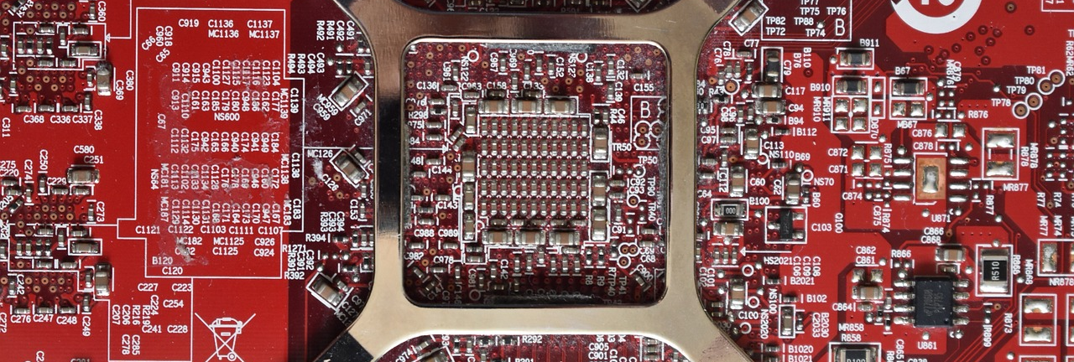
Use of AI During the Internship
AI was used as a structured research and drafting aid, with legal and technical review retained by the IP team
Where I used AI
What I built / learned
Controlled AI-assisted workflow
Prior art keyword detection: generated synonyms, technical keyword clusters, and alternate search expressions.
Standard review: supported structured reading of Wi-Fi 8 standard/proposal text for claim-element identification.
Claim drafting: helped convert technical disclosure into clearer and more understandable claim language.
Landscape creation: organized AI-driven cybersecurity patents into categories, problem areas, assignees, and opportunities.
Comparison support: extracted distinctions between invention features and prior-art references.
Built a reusable AI-assisted claim-drafting skill / prompt workflow modeled on Naveen Sir’s drafting approach.
Learned to use AI for structure, search strategy, and drafting clarity, not as a substitute for legal judgment.
Verified every AI-generated keyword, claim phrase, and interpretation against disclosure and prior art.
Improved translation of engineering ideas into patent language without losing technical meaning.
Used AI for speed, structure, and drafting clarity; final judgment remained based on technical disclosure, prior art comparison, and mentor review.
Samsung IP Internship | 02
Confidential work described at high level

